Slide 1
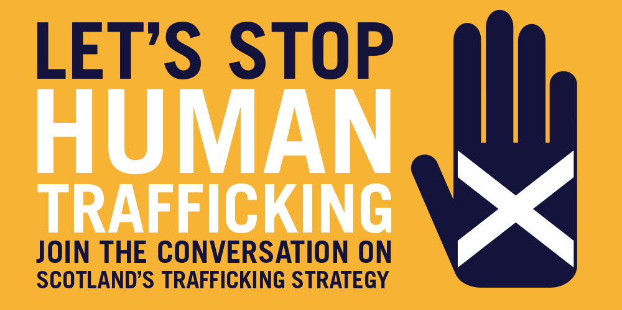
Notes:
This is a short presentation intended to give an outline of what human trafficking is, the extent to which it is happening in Scotland, what is being done to address it, and how you can help.
NB depending on the audience, some of these slides may go into more detail than is needed. If the audience is not front-line practitioners, the two slides on ‘legal definitions in Scotland’ and the slide on ‘NRM process’ may not be required.
The final slide provides links to additional resources including videos that will complement this presentation, and is not intended to form part of the presentation.
This presentation was prepared by The Scottish Government. Any enquiries to: human.trafficking@gov.scot

Slide 2
A Collective Responsibility
Identification
Protection (Adult and Child Protection responses)
Care and Support
Prevention
Prosecution
All responses should be informed by a Human Rights - led approach and an understanding of the impact of trauma.
Notes:
We have a collective responsibility to:
Proactively be aware of indicators and commit to seek help to identify or share concerns about people we think may be trafficked and exploited.
Be aware of supports in place and where to go for advice and/or to refer on
Ensure we are informed and follow adult and child protection processes and guidance to inform any actions where appropriate and ensure we are protecting survivors of trafficking and keeping them safe.
Care and Support – to ensure survivors access high quality longer term support to help with their long term recovery it is essential that we take a multi agency approach that takes collective responsibility
Prevention – from awareness of the issue, to tackling the demand for women to sexually exploit or cheap goods which drives the exploitation of vulnerable people we have a responsibility as individuals and professionals to address local and global conditions creating the space in which this crime thrives
Prosecution – by ensuring we take a trauma informed approach to identification and support with our focus on protecting vulnerable survivors we can promote intelligence and information sharing to tackle the perpetrators and bring them to justice, signalling our intent to those who profit from this abuse.

Slide 3
Simple definitions
Human Trafficking: Trading adults and children for the purpose of personal gain or profit
Slavery and servitude: Exercising ownership over someone or coercion to provide services
People smuggling: Illegal transportation of persons across a border (a crime against the state)
Notes:
These definitions are indicative rather than legal. The following slides will give a more detailed explanation of legal offences in Scotland.
People smuggling is a crime against the state rather than against the individual. People smuggling ends on arrival at destination whereas trafficking involves ongoing exploitation. People smuggling involves consent of the individual; trafficking may involve initial consent but any consent is rendered meaningless by coercive, deceptive or abusive action by traffickers.

Slide 4
Legal definitions in Scotland
Human Trafficking and Exploitation (Scotland) Act 2015
Human trafficking offence: a person takes a relevant action and does so with a view to another person being exploited
Relevant action:
Recruitment of another person
Transportation or transfer of another person
Harbouring or receiving of another person
Exchange or transfer of control over another person
Arrangement or facilitation of any of the above
Exploitation:
Slavery, servitude and forced or compulsory labour;
Prostitution or sexual exploitation;
Removal of organs;
Securing services and benefits.
Slavery, servitude and forced or compulsory labour offence:
Holds another person in slavery or servitude or
Requires another person to perform forced or compulsory labour
Interpretation of these terms to be in accordance with Article 4 of the Human Rights Convention.
Notes:
Important distinction:
The Scottish definition of trafficking does not require movement of the victim, unlike in England and Wales – it is a broader definition which encompasses most of what would be called “modern slavery” in England and Wales.
Note that “slavery servitude and forced or compulsory labour” is one type of exploitation covered by the offence.
Human Rights Convention: Convention for the Protection of Human Rights and Fundamental Freedoms agreed by the Council of Europe at Rome on 4 November 1950.
Because “slavery servitude and forced or compulsory labour” is one type of exploitation covered by the human trafficking offence, in practice this offence applies where one of the “relevant actions” has not been established (which in most cases we anticipate it would be).
The penalties for both offences are identical in the act:
On summary conviction, imprisonment for a term not exceeding 12 months or a fine not exceeding the statutory maximum (or both)
On conviction or indictment, imprisonment for life or a fine (or both)

Slide 5
Does it happen here?
Notes:
Human trafficking and exploitation is happening in Scotland, and the number of identified victims is increasing every year.
These are figures from the National Referral Mechanism (NRM), the UK’s mechanism for identifying victims of trafficking and exploitation and directing them to support. As such they show potential victims who have been identified in Scotland and who have consented to enter the NRM process. Child victims do not need to consent, so should always be entered into the NRM, but adult survivors who do not consent are not included in these figures. Further information on the National Referral Mechanism can be found on the website of the National Crime Agency.
Note the substantial increase from 2013 where 99 potential victims were identified to 228 in 2018. The spike in cases between 2016 to 2017 reflects the impact of awareness raising activity and media reporting since the new legislation and the launch of the Strategy.

Slide 6
NRM referrals
Year | Total | % increase from previous year | Female Adult | Male Adult | Female Child | Male Child
2018 | 228 | 10 | 67 | 108 | 22 | 31
2017 | 207 | 38 | 63 | 81 | 24 | 39
2016 | 150 | 34 | 54 | 49 | 21 | 26
2015 | 145 | 31 | 52 | 51 | 19 | 23
2014 | 111 | 12 | 48 | 38 | 14 | 11
2013 | 99 | n/a | 52 | 25 | 13 | 9
Notes:
The recent numbers reflect an increase in male NRM referrals as a proportion of the overall total and a significant increase since 2013 across all categories.
These numbers are likely to be the tip of the iceberg. Estimates suggest that around 25 million people are in slavery or forced labour globally.

Slide 7
Types of exploitation
Domestic servitude
May include: cooking, cleaning, laundry, child care, often (not always) living in employer’s home
Labour exploitation
E.g. nail bars, hand car washes, factory, agricultural, food industry, care work, hospitality, construction. This can also include criminal activity.
Sexual exploitation
Including commercial sexual exploitation such as prostitution, pornography, lap dancing and stripping
Notes:
Domestic servitude involves the victim being forced to work in private households. Their movement will often be restricted and they will be forced to perform household tasks such as child care and house-keeping over long hours and for little if any pay. Victims will lead very isolated lives and have little or no unsupervised freedom. Their own privacy and comfort will be minimal, often sleeping on a mattress on the floor in an open part of the house. In the rare circumstances where victims receive a wage it will be heavily reduced, as they are charged for food and accommodation.
Forced or compulsory labour involves victims being compelled to work very long hours, often in hard conditions without relevant training and equipment, ­and to hand over the majority if not all of their wages to their traffickers. Forced labour crucially implies the use of coercion and lack of freedom of choice for the victim. In many cases victims are subjected to verbal threats or violence to achieve compliance.
Often large numbers of people are housed in single dwellings and there is evidence of ‘hot bunking’, where a returning shift takes up the sleeping accommodation of those starting the next shift.
Labour exploitation can cover a wide range of work, but areas that come up a lot include: construction sites, hand car washes, nail bars, fishing, restaurants and takeaways. It can also include criminal activity such as cannabis cultivation and county lines/drug trafficking.
Sexual exploitation involves any non-consensual or abusive sexual acts performed without a victim’s permission. This includes prostitution, escort work and pornography. Women, men and children of both sexes can be victims, though the overwhelming majority of victims are female. Many will have been deceived with promises of a better life and then controlled through violence and abuse. It is also possible to exploit a person who consensually engages in providing sexual services.

Slide 8
Types of Exploitation
Type | Adult Female | Adult Male | Child Female | Child Male | Total
Domestic Servitude | 7 | 5 | 1 | 0 | 13
Labour exploitation | 6 | 93 (86%) | 5 | 29 (94%) | 133 (58%)
Sexual exploitation | 52 (78%) | 7 | 11 (50%) | 1 | 71
Unknown | 2 | 3 | 5 | 1 | 11
Notes:
Again these figures are for victims entering the NRM from Scotland. These figures cover 2018.
Key messages in these figures:
The majority of adult female victims are for sexual exploitation (78%)
The vast majority of adult male victims are for labour exploitation (86%)
The majority of male child victims are for labour exploitation as well (94%)
One in every two female child victims are for sexual exploitation (50%)
There were no victims of trafficking for organ removal in Scotland in 2018
Note that for the purposes of trafficking, a child is defined as under 18 – this is different to most contexts.
Overall, the most common reason for trafficking was labour exploitation, with 58% of cases – almost double that of sexual exploitation, which is the next most common.
The most common nationalities of adult victims in Scotland in 2018 were Vietnamese and then Chinese. The most common European countries were Romania , Albania, Poland and Slovakia.

Slide 9
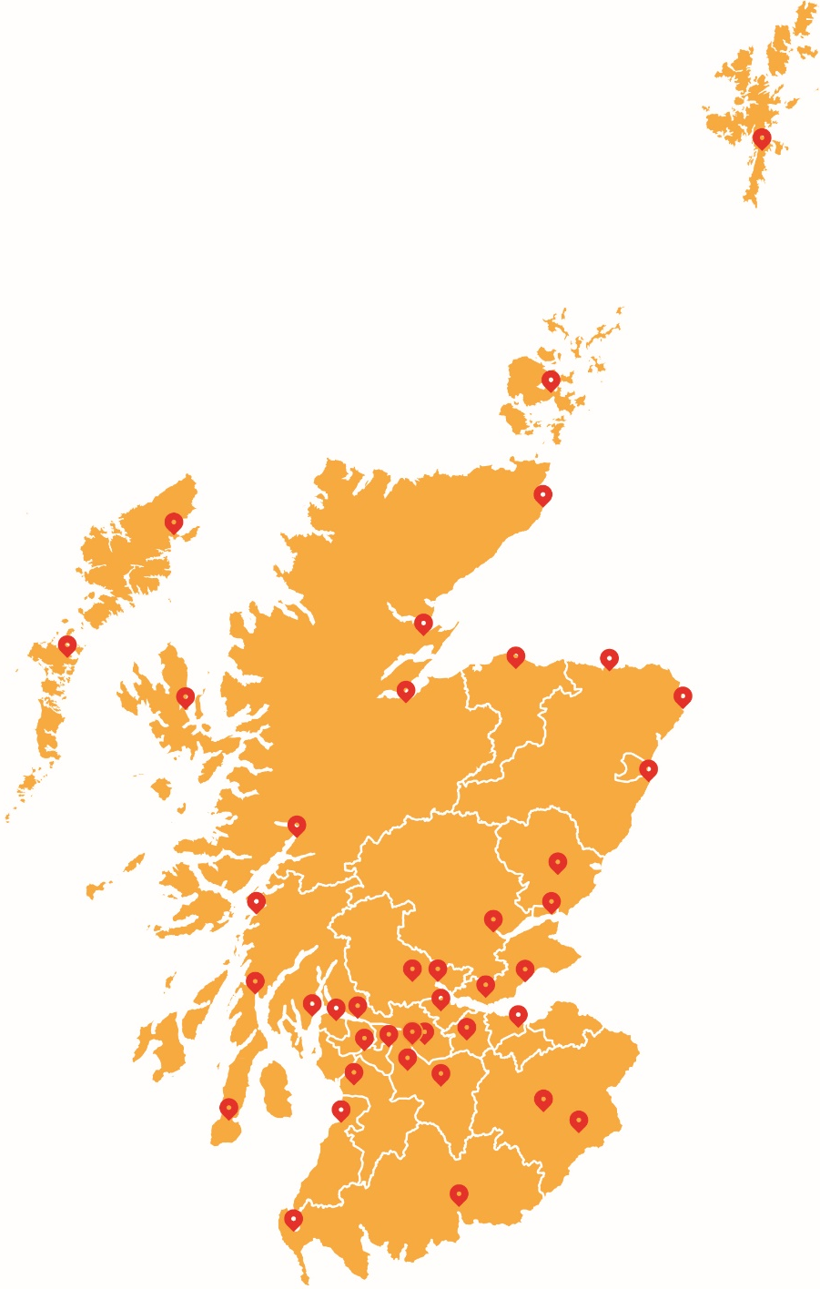
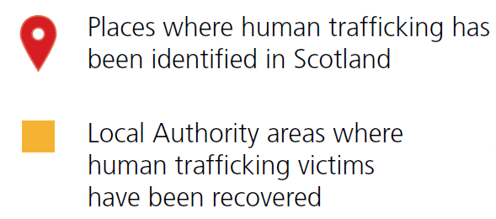
HUMAN
TRAFFICKING
IS CLOSER THAN YOU THINK
People are being trafficked in every corner of Scotland. If you see something suspicious, report it.
Notes:
Human trafficking victims have been identified across all local authorities in Scotland.
In this image, the yellow areas show local authorities where survivors have been recovered, and the red markers show specific locations were trafficking has been identified.
This issue is not just confined to specific areas – it is happening in communities across the country.

Slide 10
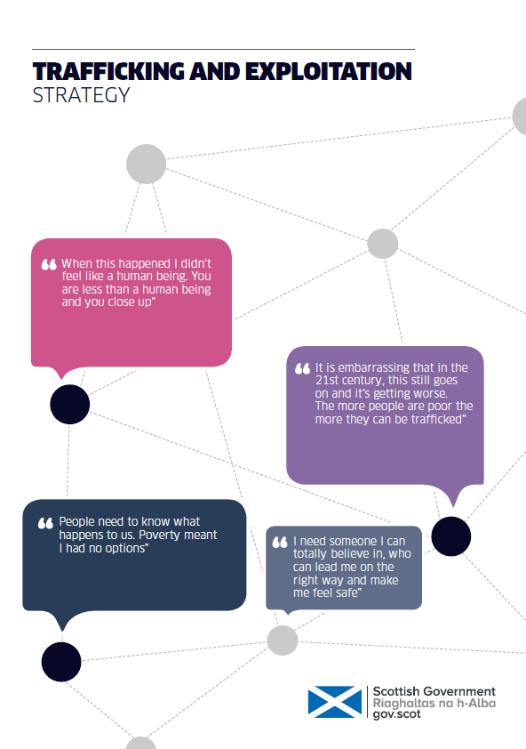
What is being done about trafficking in Scotland?
Human Trafficking and Exploitation (Scotland) Act 2015 – new offences, new powers for police and prosecutors
Trafficking and Exploitation Strategy published May 2017 includes action on:
Identifying victims and supporting them to safety and recovery
Identifying perpetrators and disrupting their activity
Addressing conditions that foster trafficking and exploitation
Specific measures to address child trafficking
Notes:
The Scottish Government’s Trafficking and Exploitation Strategy was published in May 2017. Under the Human Trafficking and Exploitation Act, the SG is obliged not just to publish a strategy, but to review and publish a new strategy after three years. The quotes on the front and throughout the strategy are from victims themselves.
The strategy sets out an ambitious set of actions to be undertaken and outcomes to be achieved. It also sets out a framework for how this will be measured.
The strategy also links in with other areas of work, for example human trafficking for commercial exploitation is included in the Scottish Government’s Equally Safe strategy for preventing violence against women and girls, and the Serious Organised Crime Strategy is relevant to work to tackle perpetrators.

Slide 11
Impact on victims
Physical health symptoms
Sexual and reproductive health symptoms
Mental health difficulties
Post Traumatic Stress Disorder (PTSD)
Anxiety
Depression
Current threat and revictimization
Impact of trauma – trust and fear
Notes:
Trafficking can have lasting negative impacts on victims. Trafficked persons often have limited access to basic necessities such as safety, food, sleep, hygiene, and medical care. The effects of trafficking vary depending on the type of trafficking and the specific situation.
All victims of trafficking may be subject to physical, psychological, and social impacts. They often experience harsh physical impacts due to excessive work or the use of force by traffickers. In addition, victims may be exposed to serious health risks, such as HIV/AIDS.
Research indicates that there is a high prevalence of mental health difficulties within this population including Post Traumatic Stress, Anxiety and Depression.
Post Traumatic Stress Disorder (PTSD) is characterised by 4 distinct clusters of symptoms:
re-experiencing symptoms (this may be in the form of flashbacks/nightmares, distressing images or physical sensations
avoidant symptoms (this can be active avoidance of distressing memories, thoughts, feelings or external reminders of the event)
negative alterations in mood and cognition (this can be severe affect dysregulation, negative view of self/others/world)
alterations in arousal and reactivity (victims may report difficulties such as hyper vigilance, sleep disturbance, cognitive impairment including concentration and memory difficulties)
Revictimisation – many victims live in fear that their traffickers will find them. Victims of trafficking are vulnerable to being re-trafficked and experiencing revictimisation within their relationships with others.
A number of these factors are particularly damaging impact for women. It is vital that responses are sensitive and responsive to the needs of female victims of trafficking.
Trafficked minors are all the more vulnerable due to their age. Trafficking may greatly impact children’s emotional, physical, and overall psychological development.
Due to their experiences, victims of trafficking may have a number of issues, including:
Trust - not trusting professionals
it’s common for them to keep secrets and tell rehearsed stories that their traffickers have told them to repeat.
Professionals working with victims should be mindful of this.

Slide 12
Impact on victims
Stronger Together – Daniel and Weronika’s Story
Notes:
This is a short video produced by Stronger Together, a multi-stakeholder business-led initiative aiming to reduce Human Trafficking - particularly forced labour, labour trafficking and other hidden third party exploitation of workers.

Slide 13
NRM process
Concern that someone may have been trafficked
⬇
A FIRST RESPONDER makes a referral to the SINGLE COMPETENT AUTHORITY
⬇
Reasonable Grounds decision: positive = 90 day statutory support period
⬇
Aftercare provider services
⬇
Conclusive Grounds decision
⬇
Exit care
Notes:
The National Referral Mechanism (NRM) is the UK’s framework for identifying individuals who are victims of human trafficking and slavery, servitude and forced or compulsory labour and ensuring they receive the appropriate support.
Informed consent is required for an adult victim to enter the NRM process. TARA or Migrant Help can offer advice and guidance on this.
Whilst children are referred into the NRM, child trafficking is child abuse and should be treated within a child protection context. Support for child victims will be provided by social work regardless of the NRM decision and is not limited to 90 days.
Initial referral
To be referred to the NRM, a potential victim of human trafficking must be referred to a body called the Single Competent Authority (SCA). The SCA makes decisions on all NRM cases, regardless of nationality or immigration status of the individual.
The referral is made by an authorised agency called a First Responder. A First Responder is a member of staff within certain designated agencies who have direct or indirect contact with a person who is believed to have been trafficked. A range of agencies are designated as First Responders. In Scotland First Responders include: Police Scotland, TARA, Migrant Help, Local Authorities (for child victims), Home Office Immigration Enforcement, UK Border Force, UK Visas and Immigration.
NRM decision-making
The NRM Process begins with a quick Reasonable Grounds decision (target of five working days), for which the threshold is ‘I suspect but cannot prove’ the person is a victim of human trafficking, or the person is a victim of slavery, servitude, and forced or compulsory labour.’
The SCA will consider whether a reasonable person having regard to the information available, would think there are Reasonable Grounds to believe the individual had been a victim of human trafficking.
The Conclusive Grounds decision takes longer and there is no target for this decision. The threshold is that on the balance of probability, “ it is more likely than not that the individual is a victim of human trafficking”.
Between Reasonable Grounds and Conclusive Grounds (or for 90 days from Reasonable Grounds whichever is shorter), a statutory period of support applies, set out in the 2015 Trafficking Act. In practice, potential victims are supported before the Reasonable Grounds decision and some level of support will often continue after the statutory period, on the basis of individual needs assessment.
After a Conclusive Grounds decision
If the victim is from outside the United Kingdom they may be granted discretionary leave to remain in the UK for a renewable period of up to 30 months to allow them to co-operate fully in any police investigation and subsequent prosecution or for reasons dependent on their personal circumstances or to pursue compensation.
If the victim is from outside the European Economic Area, the victim can receive help and financial assistance to return home through the Assisted Voluntary Return of Irregular Migrants (AVRIM) process. If they are an EEA national the support provider will assist with a safe repatriation to the country of origin.
What if the referred person is not found to be a victim and is from outside the UK?
If it is decided by the SCA that the person was not trafficked, and there are no other circumstances that would give them a right to live in the UK, they will be offered support to voluntarily return to their country of origin. The person can also be offered support to return to their country if they have been trafficked and do not wish to stay in the UK.

Slide 14
Possible signs of Human Trafficking
Passport or documents held by somebody else
Others speaking for the person you are talking to
Expression of fear or anxiety
Excessive working hours
Highly distrustful of authorities
Not knowing address of where they work or live
Poor or sub-standard living accommodation
Lack of access to earnings
Any evidence of control over movement either as an individual or as a group
Notes:
Human Trafficking is a hidden crime. Trafficking and exploitation victims are likely to be discovered when dealing with other matters as they are often reluctant to engage with Police and support services to declare what has happened to them.
They are often coerced into committing crime on behalf of their controllers.
Victims of trafficking and exploitation don’t always self-identify as being exploited. They may see their current situation as an improvement on past experiences. If an orphaned street child living in extreme poverty is offered food and shelter in exchange for cleaning, cooking and looking after children in a family home, they may see this as better than living on the streets despite their role as a domestic servant.
Victims may also have difficulty identifying their trafficker as the person who has exploited them because they are a relative, primary care giver or have an emotional or financial dependency on that individual.
Victims can be too frightened to tell someone about what has or is happening to them. Traffickers seek to control and manipulate them by:
threats of physical violence to them or their family;
by misinforming them that the authorities won’t believe them, will imprison or deport them; and
by isolating them from others and limiting their freedom of movement
The indicators on this slide are just some of the signs that can help you establish if a person is a potential victim of trafficking.

Slide 15
How to report a concern
Police Emergency 999
Police Non-emergency 101
Modern Slavery Helpline 0800 0121 700
Crime Stoppers 0800 555 111
GLAA Help Line 0845 602 5020
Migrant Help 0141 884 7900 (daytime) 0141 212 8553 (OOH)
TARA 0141 276 7724 (24/7)
Scottish Guardianship 0141 445 8659
Service
Notes:
There are a range of routes for getting more information or reporting concerns, whether you are a professional or member of the public.
If you have an urgent concern or if someone is at immediate risk, you should call the police on 999 or 101.
The Modern Slavery Helpline and its website is a useful resource for getting more information or reporting concerns.
Crime Stoppers offers a route to anonymously report concerns.
The Gangmasters and Labour Abuse Authority (GLAA) is a regulatory body with a particular focus on agriculture, horticulture shellfish gathering, and any associated processing and packaging.
TARA support women survivors of trafficking for commercial sexual exploitation; Migrant Help supports all other adult trafficking victims in Scotland. Both organisations will provide advice and guidance.
The Scottish Guardianship Service offers advice and guidance in relation to trafficked children.
Feedback
It would be very helpful to receive feedback, both from those delivering the presentation and those it is being delivered to. We have prepared a short evaluation sheet (available online alongside the presentation) and would be very grateful if this could be completed and returned to the Scottish Government Human Trafficking mailbox (human.trafficking@gov.scot) to assist us in developing these slides.

Slide 16
Additional resources
Trafficking and Exploitation Strategy: http://www.gov.scot/Publications/2017/05/6059/0
GLAA “Horse Trading” video: http://www.gla.gov.uk/who-we-are/modern-slavery/
Modern Slavery Helpline: https://www.modernslaveryhelpline.org/scotland
Stronger Together videos: https://www.youtube.com/channel/UC7zOkzb6LqE1qEwmF7r_3gw
Independent Anti-Slavery Commissioner: http://www.antislaverycommissioner.co.uk/
More links for legislation and guidance: http://www.gov.scot/Topics/Justice/policies/reducing-crime/human-trafficking/Furtherreading
Scottish Government: human.trafficking@gov.scot
Notes:
This slide is not intended to form part of the presentation

